Slide 1
Loading Balance Problem
Zhiyuan Wang
12032878
Greedy loading balance strategy

Slide 2
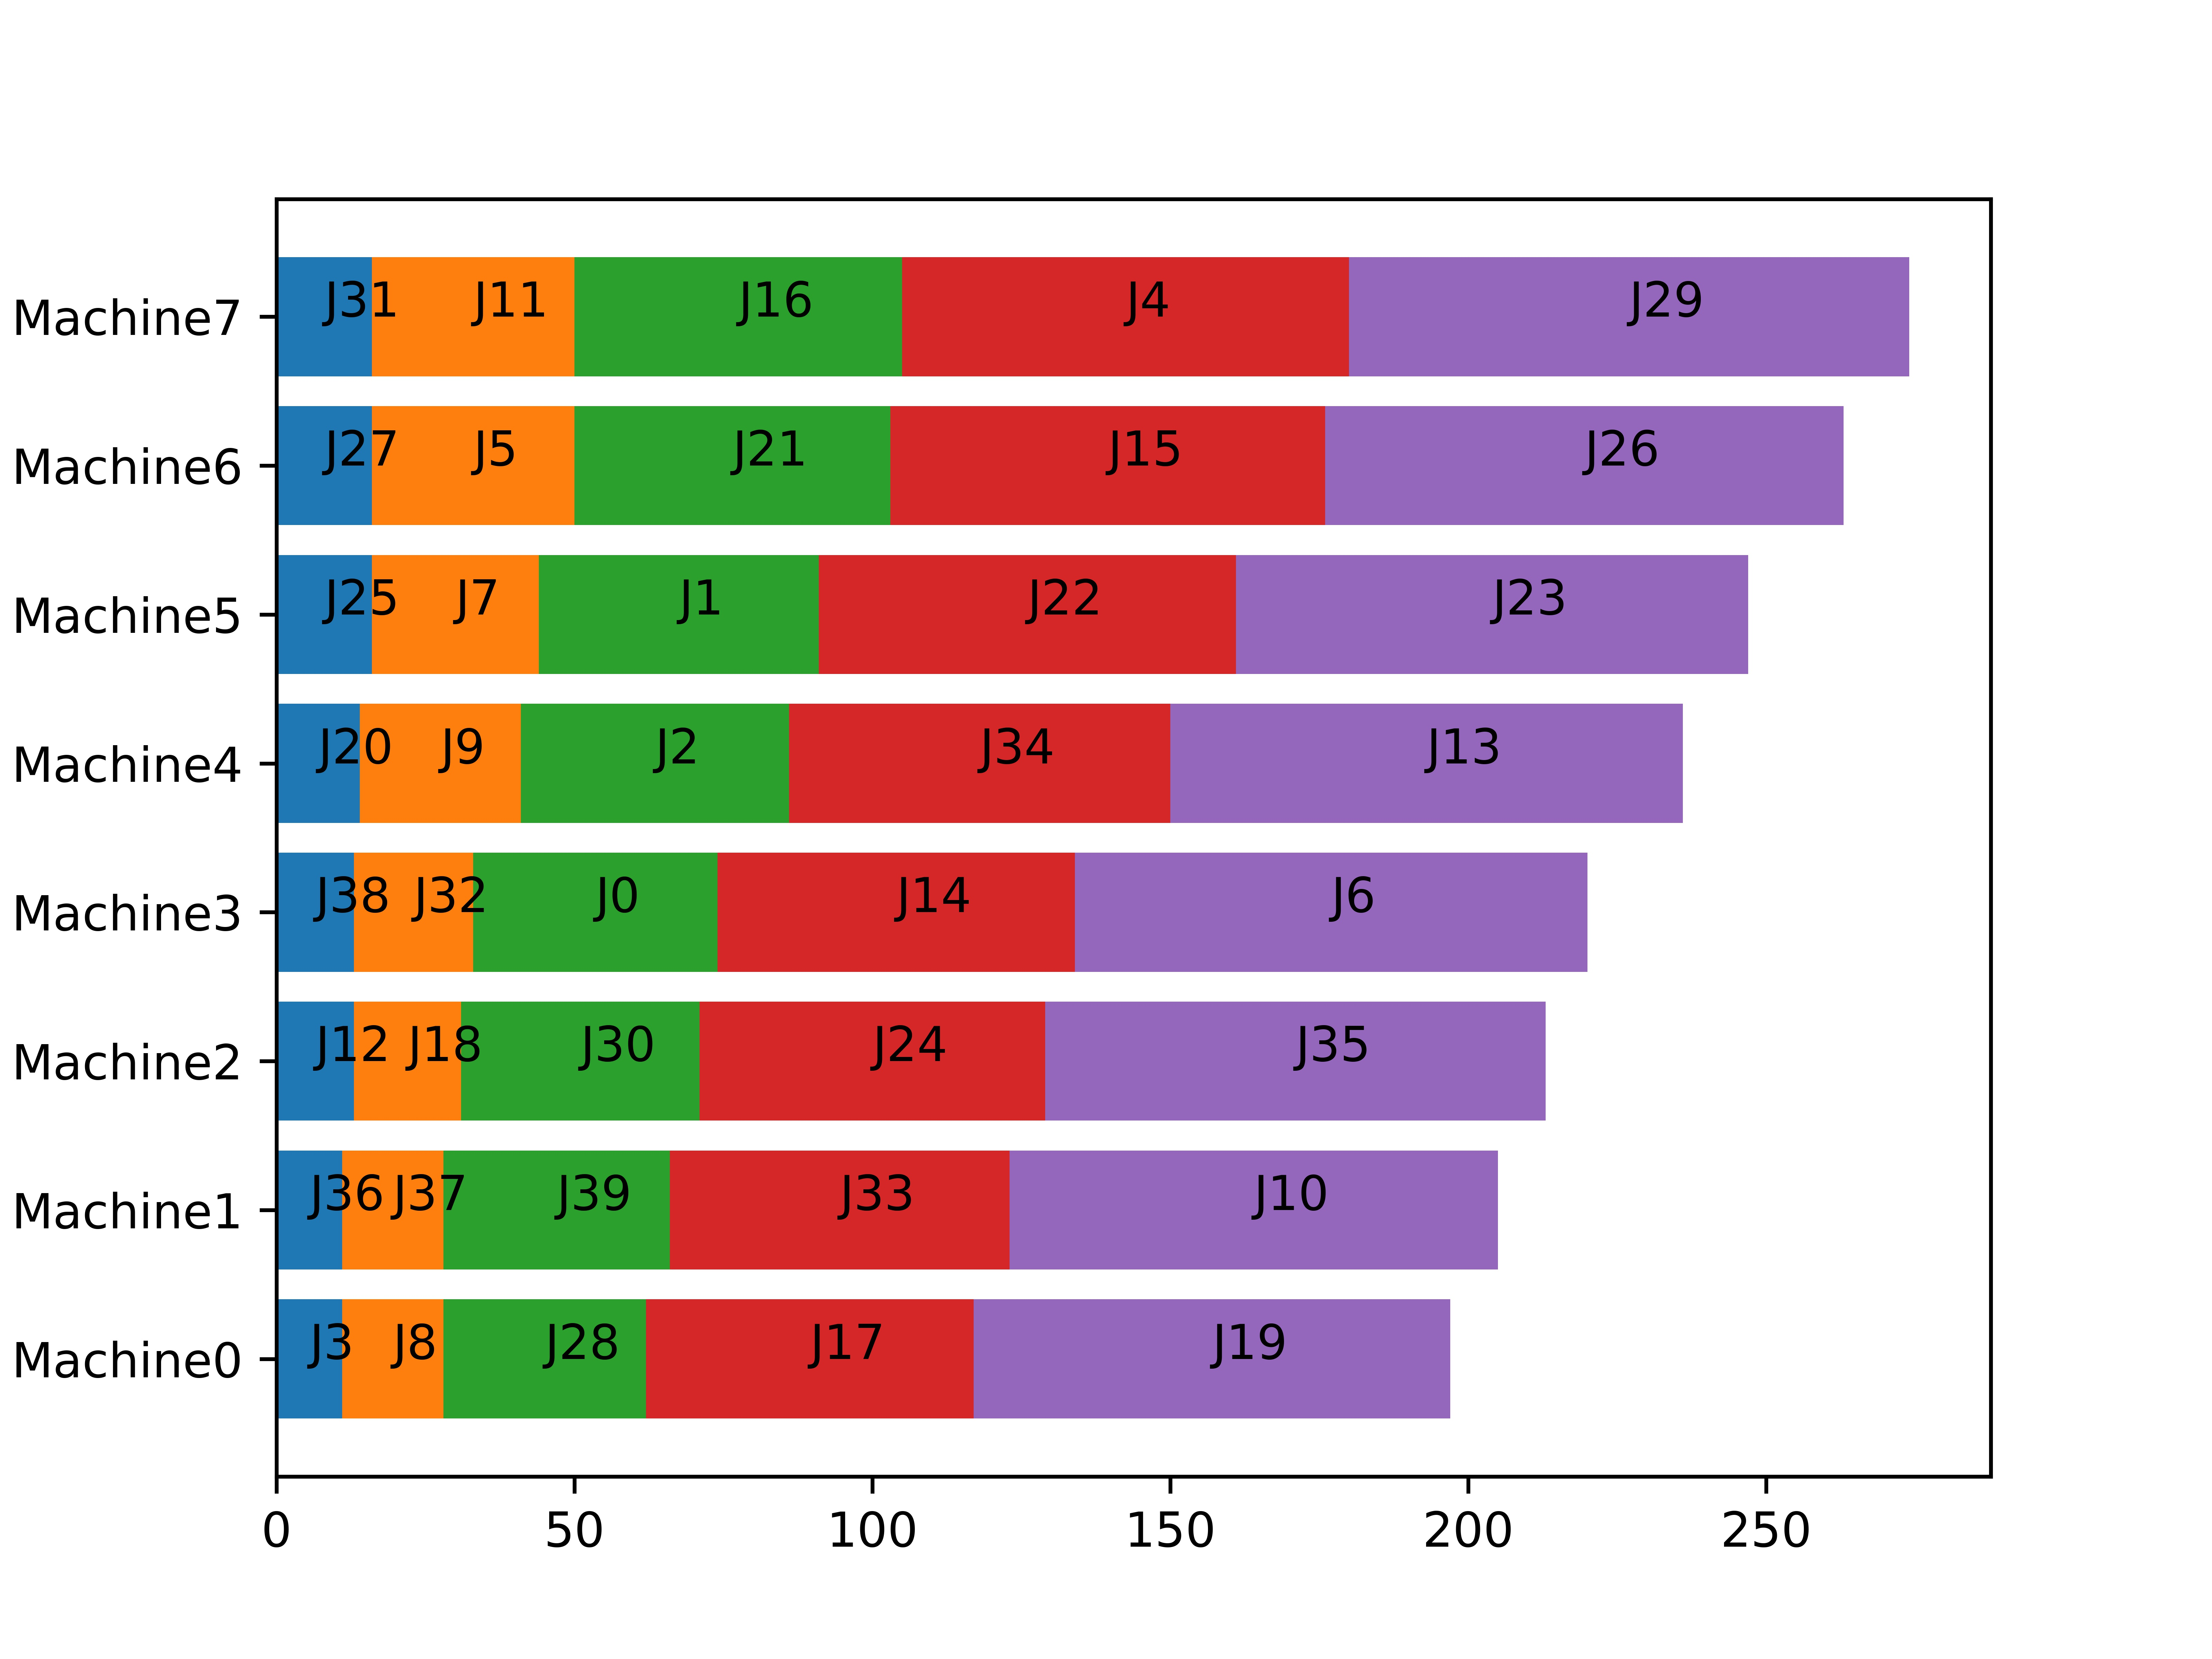
Loading Balance Problem
This problem’s target is assign jobs to computing machines to minimizes the total time consumption.

Slide 3
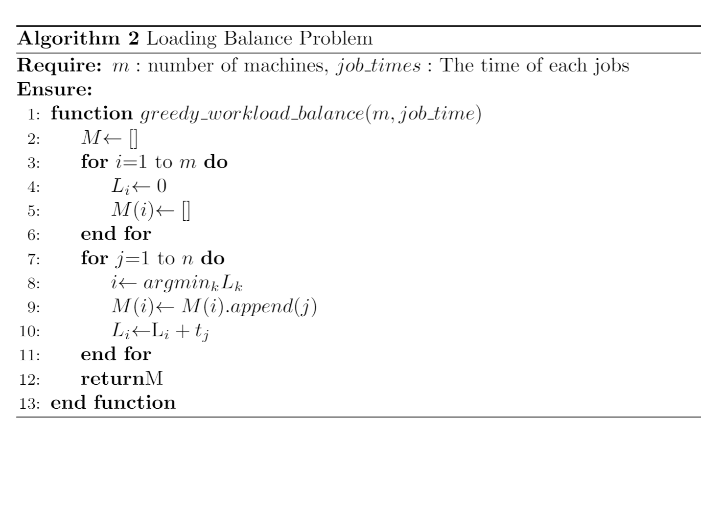
Greedy loading balance strategy
This strategy will assign a job to the machine with the smallest load in an arbitrary order of jobs.

Slide 4
Effect of algorithm
If the theoretical optimal makespan of the job queue is T*, then the greedy algorithm’s makespan T will not worse than 2T*.
$$T^{∗}≤T≤2T^{∗}$$

Slide 5
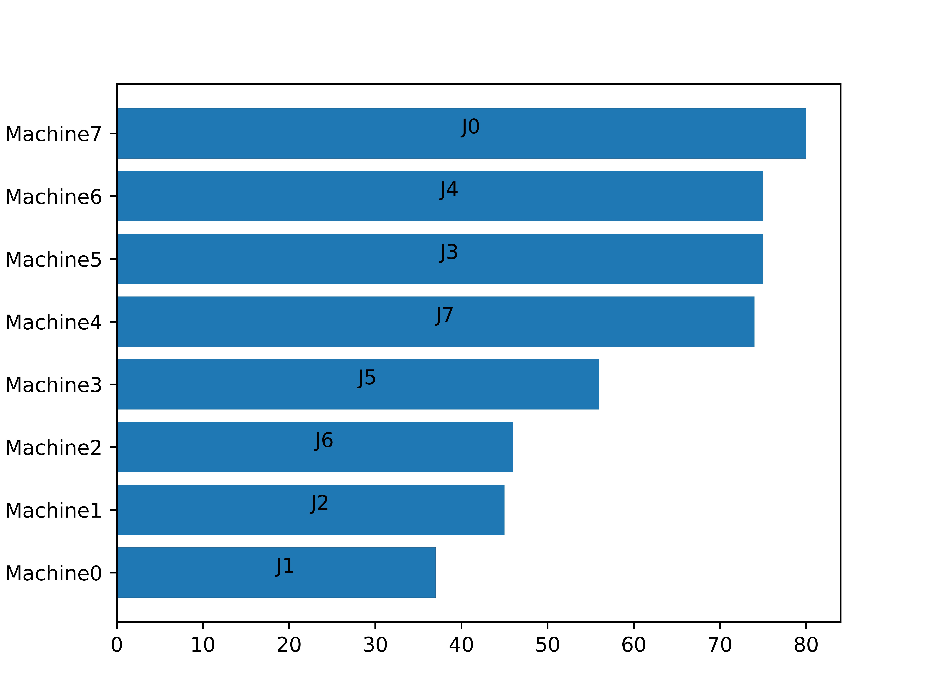
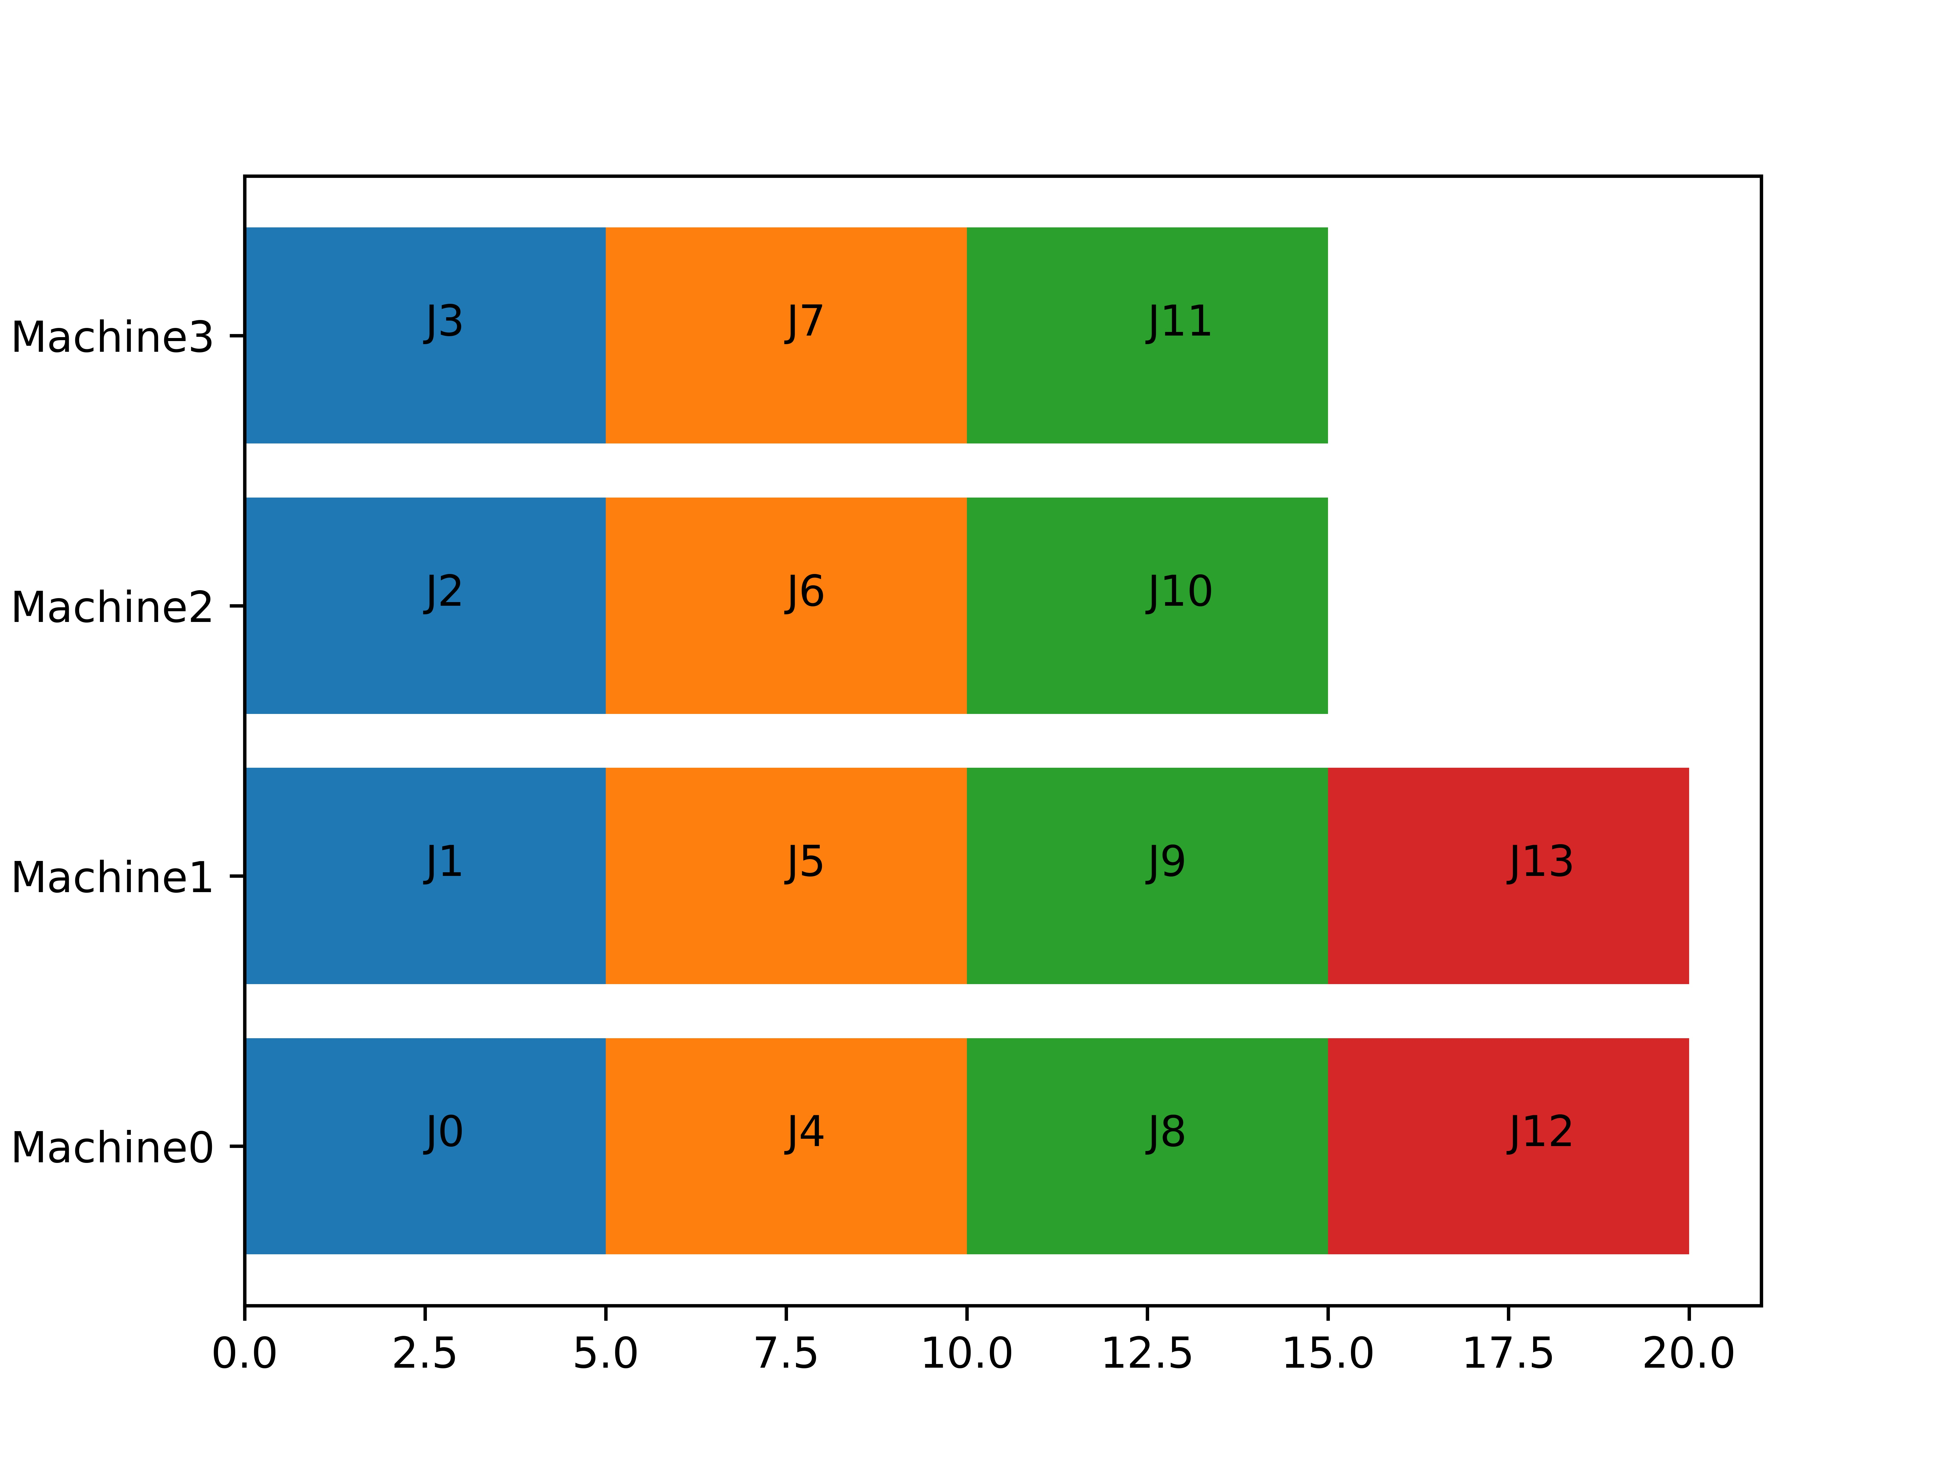
The first Example
You want a example that the makespan T equal to the T*? It’s so easy!
What if the number of the jobs equal to the jobs of machine?
What if that each jobs need the time?

Slide 6
The second and third Example
These two question can be answered by one case.
Let’s suppose that there are m machines, and the minimum unit of time is 1.
What if we have m jobs with time m, and m jobs with time 1?
Let's consider two scenarios
Let the jobs queue be: [m, m, m, ……, m, 1, 1, ……, 1, 1]
Let the jobs queue be: [m, 1, m, 1, m, 1, ……, m, 1, m, 1]

Slide 7
The second and third Example
These two question can be answered by one case.
Let’s suppose that there are m machines, and the minimum unit of time is 1.
What if we have m jobs with time m, and m jobs with time 1?
Let's consider two scenarios
Let the jobs queue be: [m, m, m, ……, 1, 1, ……, 1, 1, m]
Let the jobs queue be: [m, 1, m, 1, m, 1, ……, m, 1, m, 1]

Slide 8
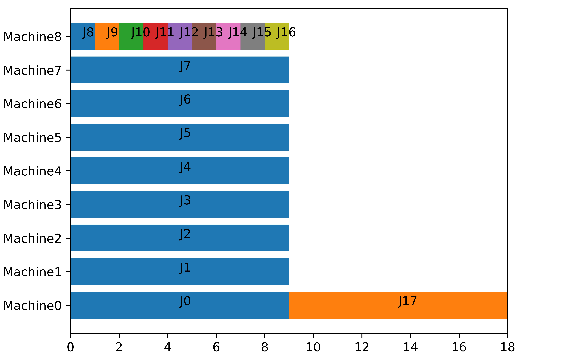
The second and third Example
These two question can be answered by one case.
Let’s suppose that there are m machines, and the minimum unit of time is 1.
What if we have m jobs with time m, and m jobs with time 1?
Let the jobs queue be: [m, m, ……, m, 1, 1, ……, 1, 1, m]

Slide 9
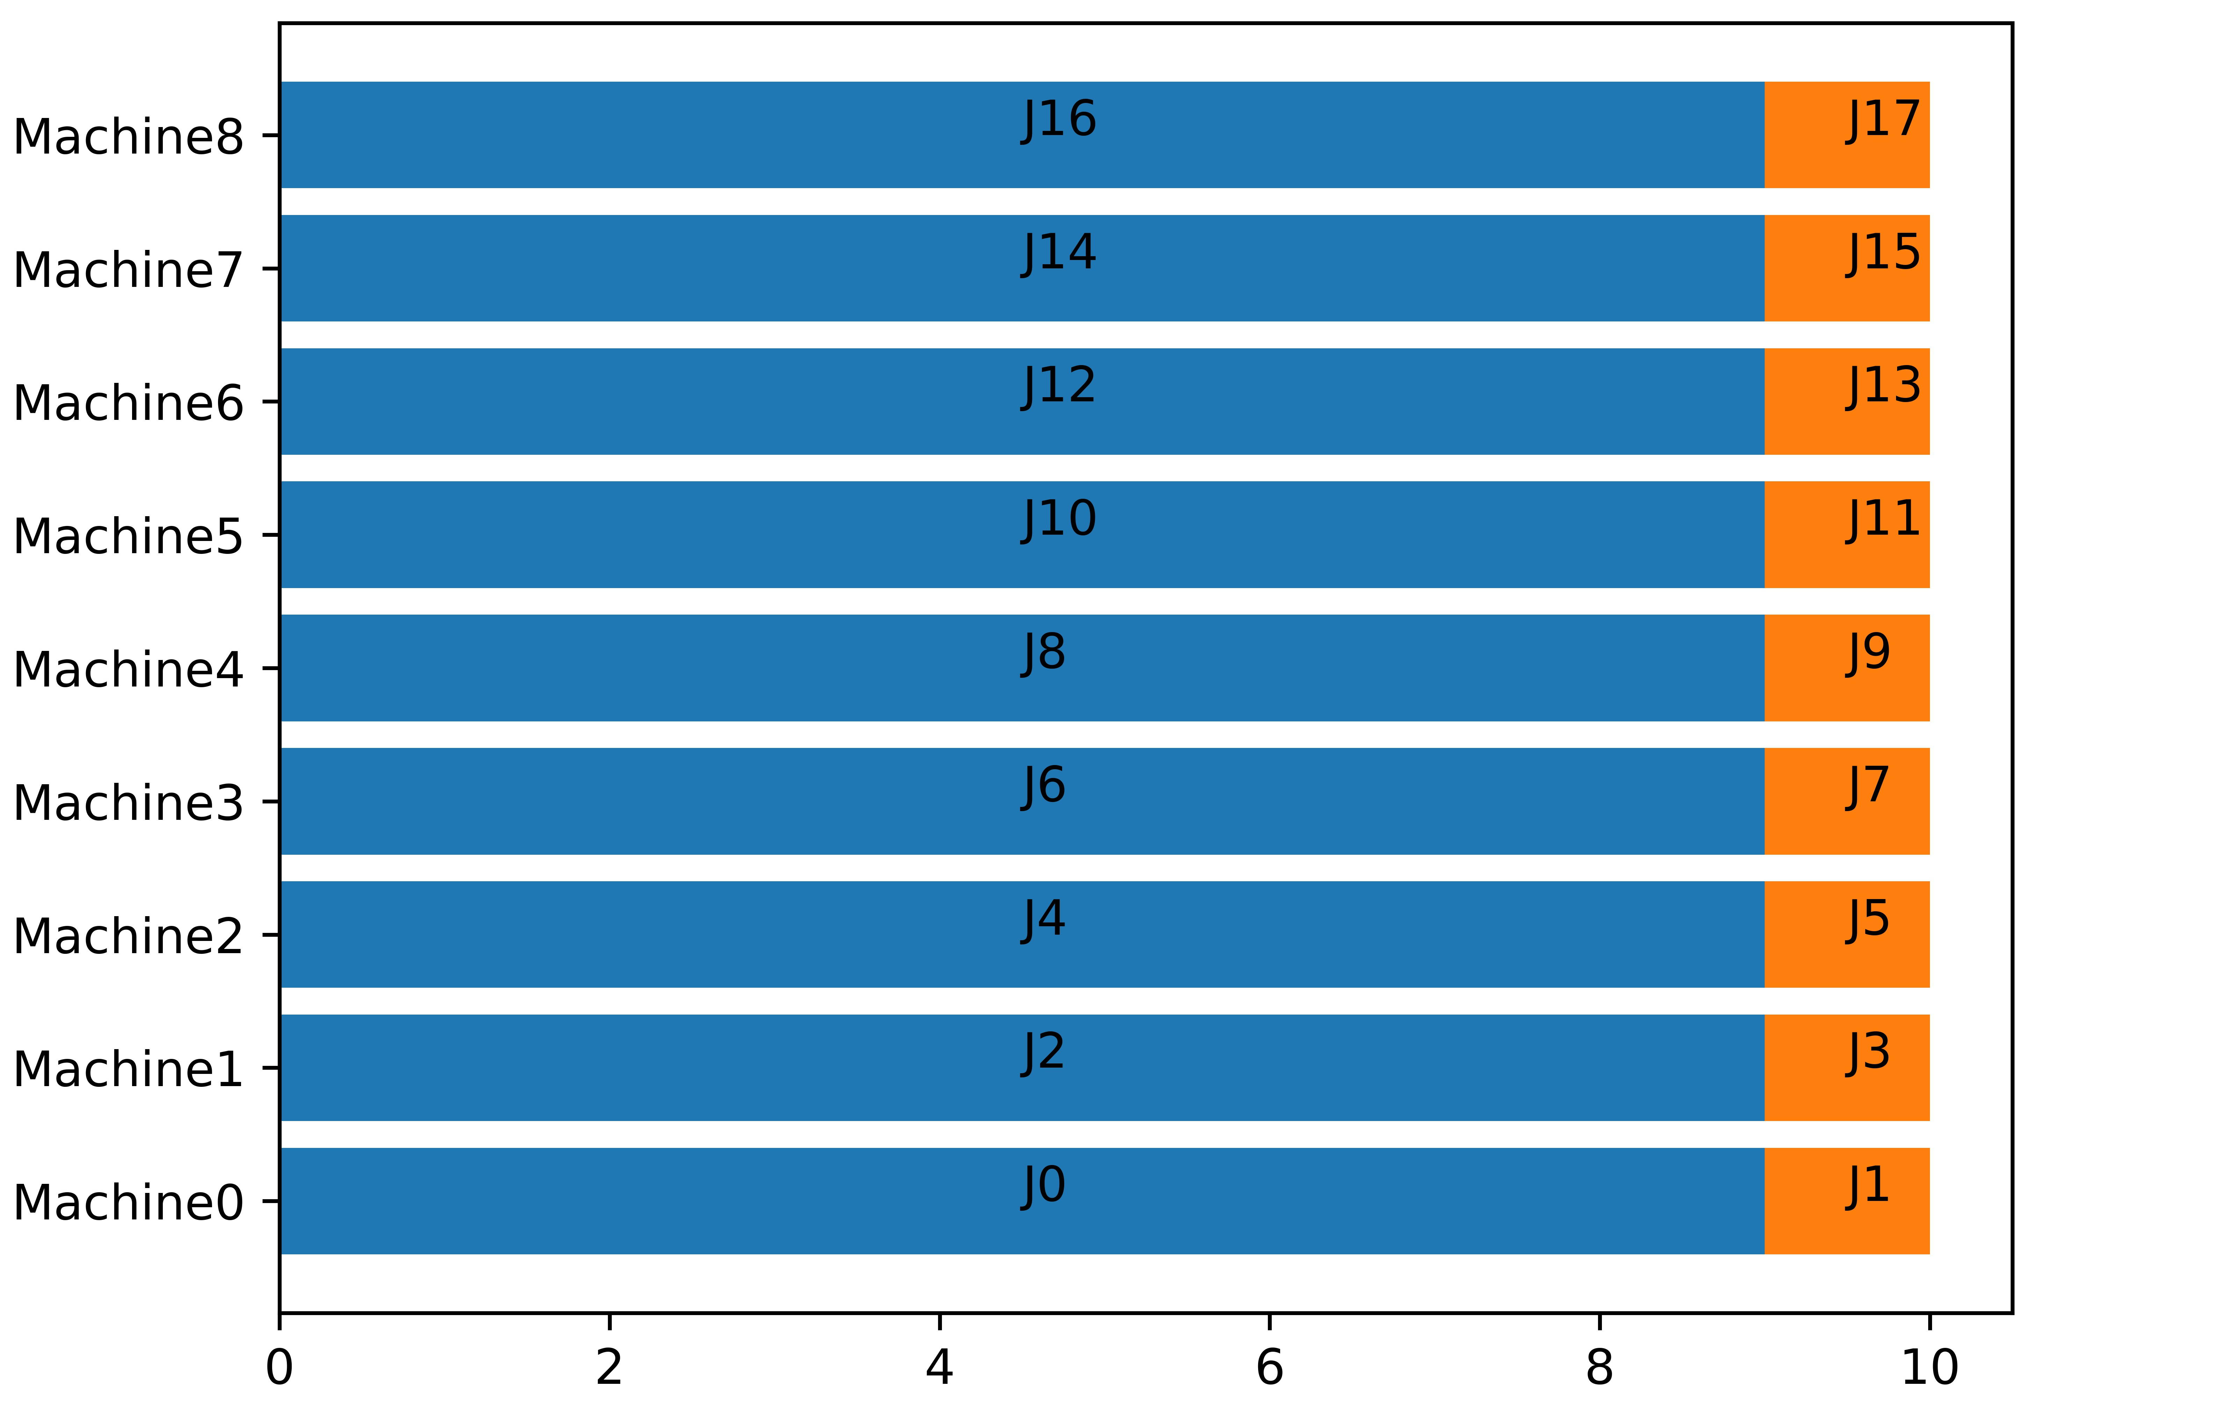
The second and third Example
These two question can be answered by one case.
Let’s suppose that there are m machines, and the minimum unit of time is 1.
What if we have m jobs with time m, and m jobs with time 1?
Let the jobs queue be: [m, 1, m, 1, m, 1, ……, m, 1, m, 1]

Slide 10
The second and third Example
These two question can be answered by one case.
Let’s suppose that there are m machines, and the minimum unit of time is 1.
What if we have m jobs with time m, and m jobs with time 1?
For the two examples above:
When the job queue is [m, 1, m, 1, m, 1, ……, m, 1, m, 1], the result of the greedy algorithm is optimal, T=T*=m+1
When the job queue is [m, m, m, ……, m, 1, 1, ……, 1, 1, m], it will get the worst solution of the greedy algorithm, T=2m
So, for these jobs, the result can equal to T*, and also can equal to 2T*-2, which is depend on the order of the jobs.

Slide 11
Thank You !
Q&A

